Slide 1
Disentangled Person Image Generation
梁天保

Slide 2
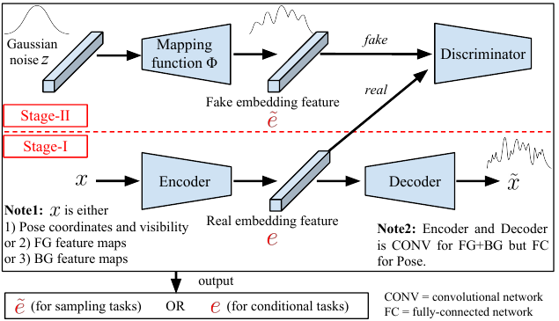
Method Overview

Slide 3
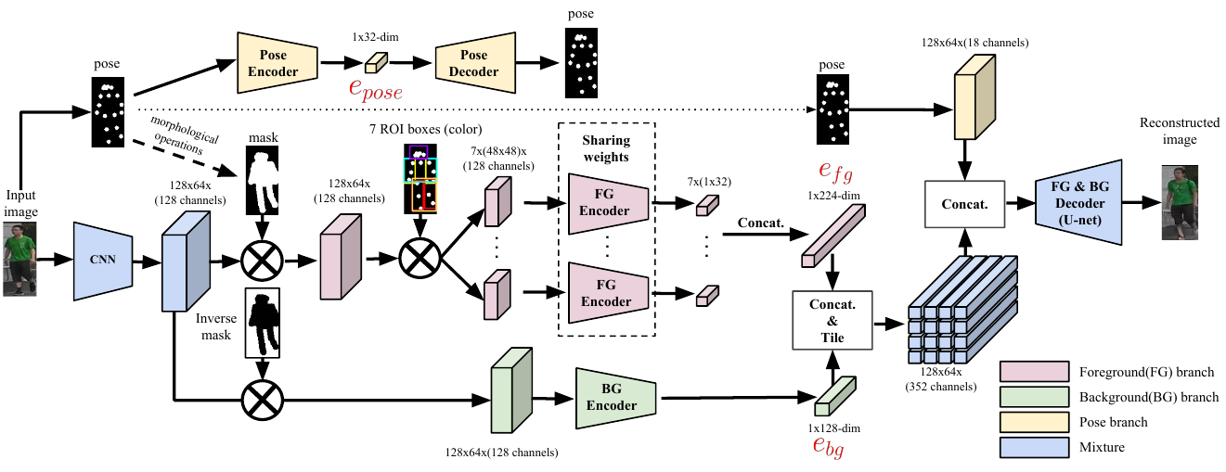
Stage-1

Slide 4
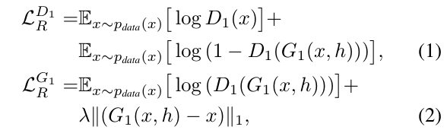
Stage-1
overall losses for fg and bg reconstruction network
x: person image ; h : pose heatmaps ;
λ : the weight of L1 loss

Slide 5
Stage-1
L2 loss for pose reconstruction
γ : keypoint coordinates ;
α : visibility

Slide 6
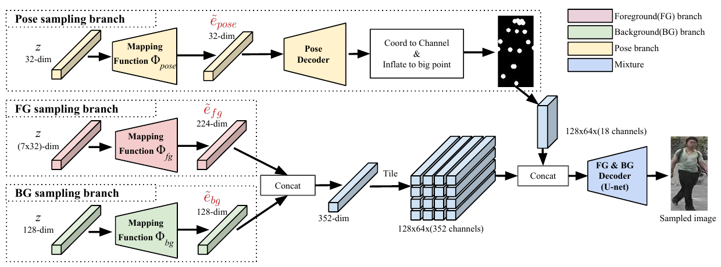
Stage-2

Slide 7

Stage-2
overall losses for Φ and D2
е : embedding features;
z : Gaussian noise

